Slide 1
Cardio Good Fitness Project
Sandhya Nair
OCT 2020

Slide 2
Objective
Perform preliminary data analysis of the given data set
Explore the dataset to identify differences between customers of each product
Explore relationships between different attributes of the customer
Provide insights based on analysis that will help the company in targeting new customers

Slide 3
Data Information
Variable | Description
Product | The model no. of the treadmill
Age | in no of years,of the customer
Gender | of the customer
Education | in no of years,of the customer
Marital Status | of the customer
Usage | Average # times the customer wants to use the treadmill every week
Fitness | Self rated fitness score of the customer
Income | of the customer
Miles | expected to run
Observations | Variables
180 | 9
There are no missing values in the dataset Gender ,Marital status & Product variables need to be converted to categorical type

Slide 4
Exploratory Data Analysis-Univariate
Products available
Product | Available No
TM195 | 80
TM498 | 60
TM798 | 40

Slide 5
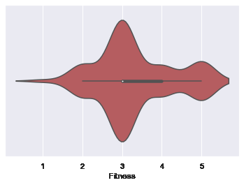
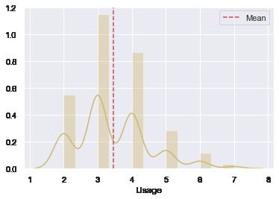
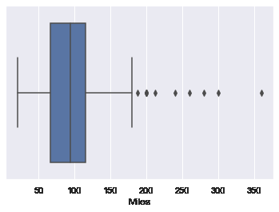
Analysis of customer Usage,Fitness and Miles run
Observations:
The average usage of the treadmills is 3
times per week
Most of the customers have a
self rated fitness score of 3.
50% of customers run between
66 and 114 miles per week
We can see few outliers which
means there are few customers who
run more than 175 miles

Slide 6
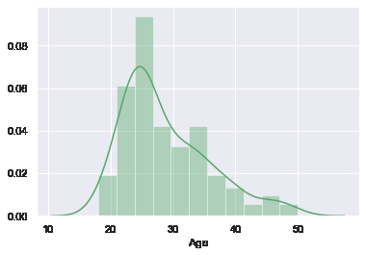
Exploratory Data Analysis-Customer Age
Age of customers
Observations:
There are a large number of
customers in the age of
around 25 years

Slide 7
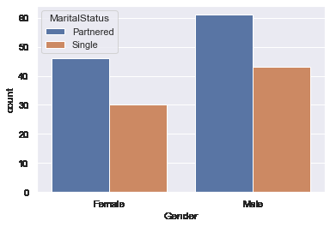
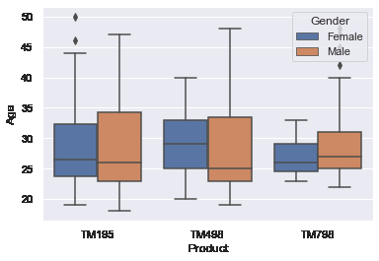
Exploratory Data Analysis-Customer vs Product Analysis
Product vs Customer Gender & Marital Status
Observation:
There are 76 Female customers
and 104 Male customers
There are more Partnered
customers than Single
There are more customers for the
TM195 product

Slide 8
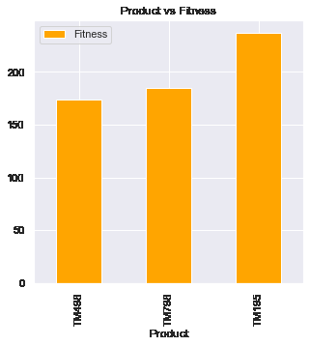
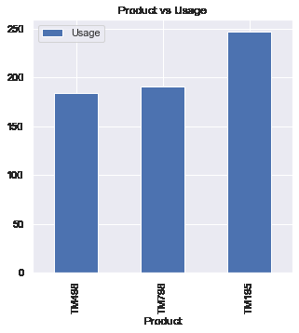
Exploratory Data Analysis-Usage,Fitness vs Products
Observation:
The product TM195 is the
most used product among
the three products
The customers who use
TM195 product have rated
themselves higher for the
fitness score

Slide 9
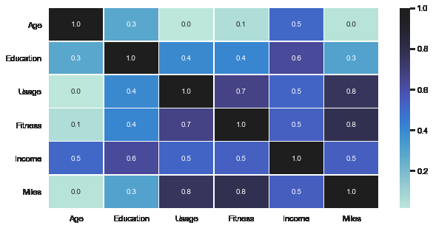
Exploratory Data Analysis-Correlation matrix
Correlation Matrix
Observations:
1.Fitness and Miles run per week
have high correlation
2.Usage and Miles run per week
have high correlation

Slide 10
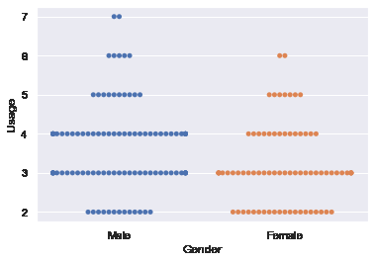
Exploratory Data Analysis-Gender and Usage
Gender vs Usage
Observations:
Most of the Male and Female
customers use the treadmill
average 3 times per week.
Male customers tend to use
it more times per week
than female customers.

Slide 11
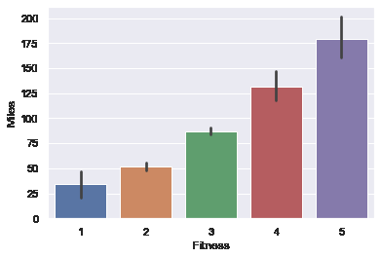
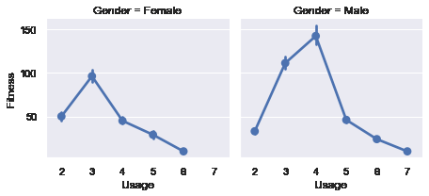
Exploratory Data Analysis-Fitness vs Miles & Usage between Male and Female customers
Observations:
As the miles run increases the fitness score of the customer increases
For Male customers the fitness score is high with a usage of the product 4 times a week
For Female customers , the fitness score is high with a usage of the products 3 times a week

Slide 12
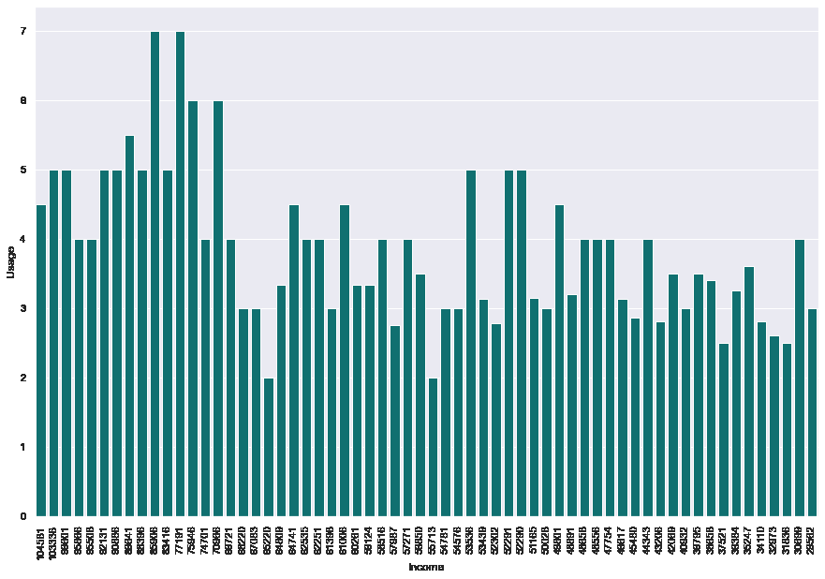
Exploratory Data Analysis:Income vs Usage
Observation:We can see more usage per week for the high Income customers

Slide 13
Conclusion
We have analyzed the dataset of 180 observations for the treadmills products and the customers of the Cardio Good Fitness Store.
Some of the main features that were considered for analyzing the dataset are the Product,Usage and Fitness.
We have concluded that:
TM798 is the most used product among the three available treadmill products and it is also the most available one in the store.
There are a large number of customers in the age of around 25 years.
There are more Male customers than Female customers.
The usage of the products for Male customers tend to be more than female customers.
The customers who used TM798 tends to rate themselves with a higher fitness score.
The fitness score of the customer seems to increase as they run more miles.
Intrestingly the fitness score seems to be the most when the usage is 3 to 4 times per week for both Male and Female customers.
8.Could not find any significant decrease in the mile run as the customer age increases.
9.The usage seems to be more for the high income customers.

Slide 14
Interestingly the fitness score seems to be the most when the usage is 3 to 4 times per week for both Male and Female customers.
Could not find any significant decrease in the mile run as the customer age increases.
The usage seems to be more for the high income customers.

Slide 15
Recommendations:
The product TM1798 is the most sought after product.Consider investing in buying more of this product
There is a need to attract more customers of older age groups
Need to attract more female customers
Consider providing more offers to low income customers

